Slide 1
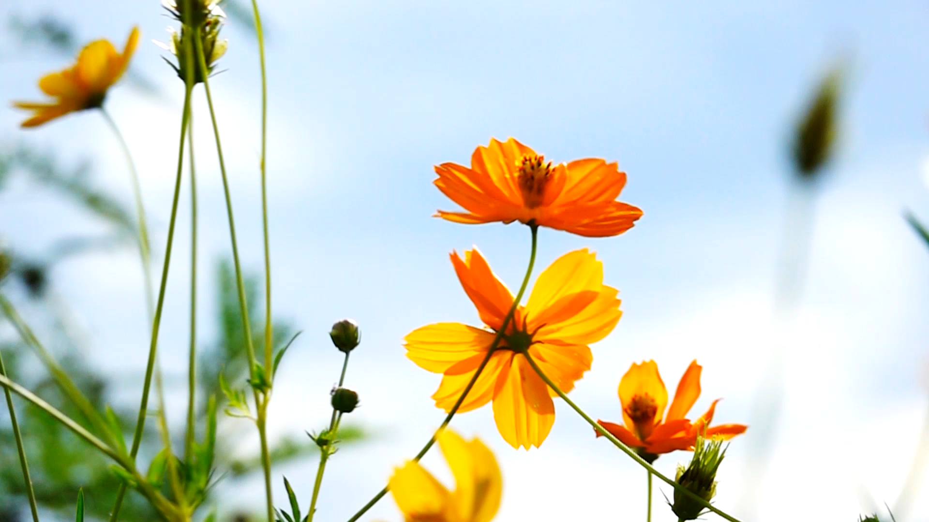
Flowering time Candidate Genes

Slide 2
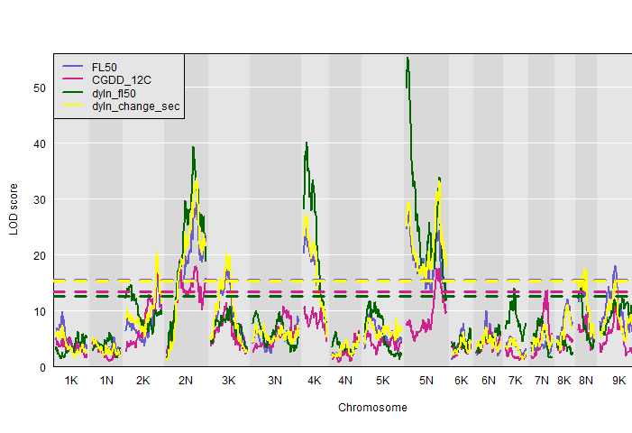
2019 flowering time data – two mapping pops
Fourway cross: Major QTL on Chr05N for flowering as a function of daylength and cumulative growing degree days
Diversity Panel: GWAS on same (50% flowering) traits in individuals from the same genetic subpops (Gulf and Midwest).
18 GWAS total

Slide 3
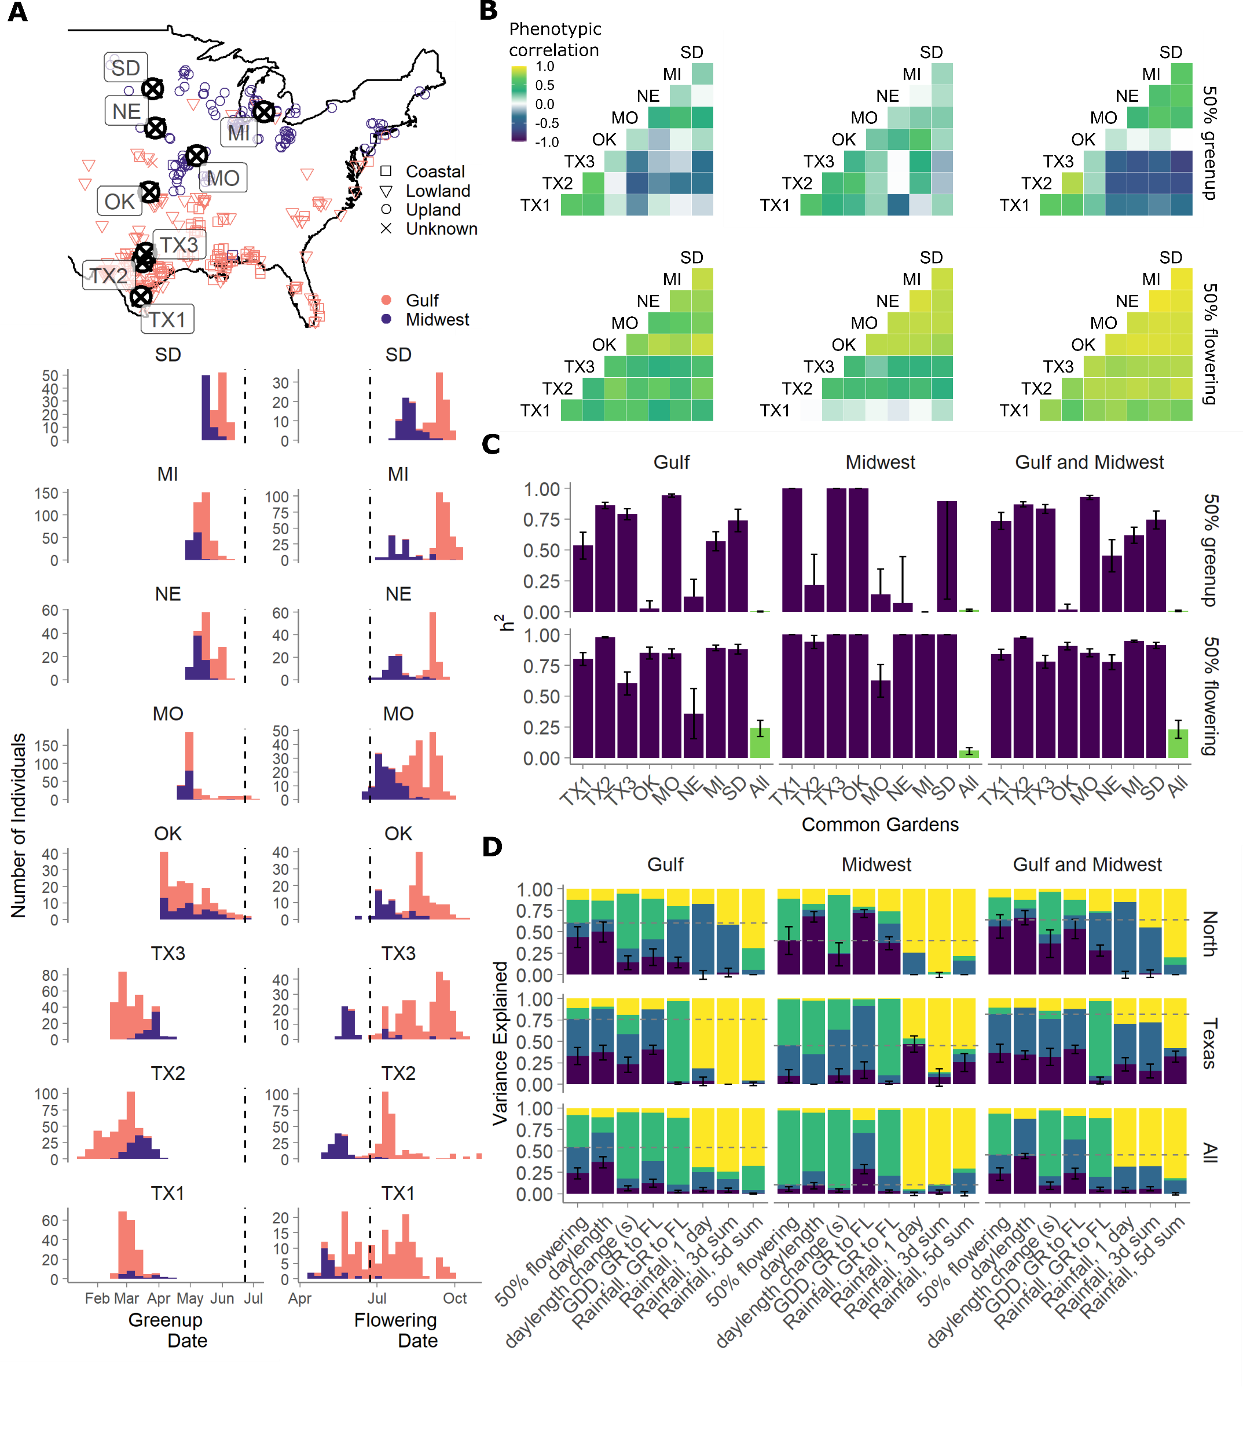
18 GWAS total
On genetic BLUPs (panel D)
phenotype ~ random(site) + random(kinship) + random(site*kinship)
For two traits
Daylength & cumulative GDD
For three population sets
Gulf, Midwest, and both
In three environment sets
Texas sites, North sites, All sites

Slide 4
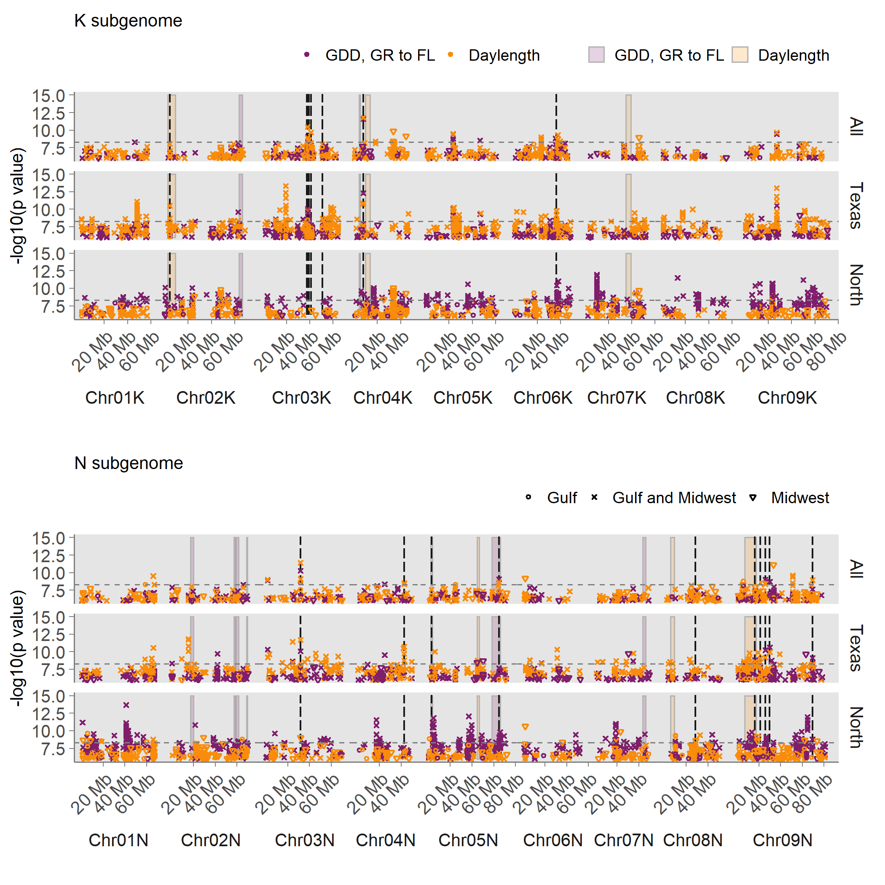
Two overlaps on Chr05N between the fourway QTL (bars) and several GWAS (points)

Slide 5
Candidate genes on Chr05N
Candidate genes on Chr05N may underlie consistent genetic effects detectable in multiple mapping populations across the species’ natural range.
Chr05N 64.84 Mb Pavir.5NG109745 DOF
Chr05N at 64.86 Mb, which was significant across subpopulations at all three sets of gardens
Top SNPs are 4110 bp from this gene.
Dof-type zinc finger DNA-binding family protein (AT2G28510)

Slide 6
Chr05N 2.79Mb 175bp from gene Pavir.5NG031900

Slide 7
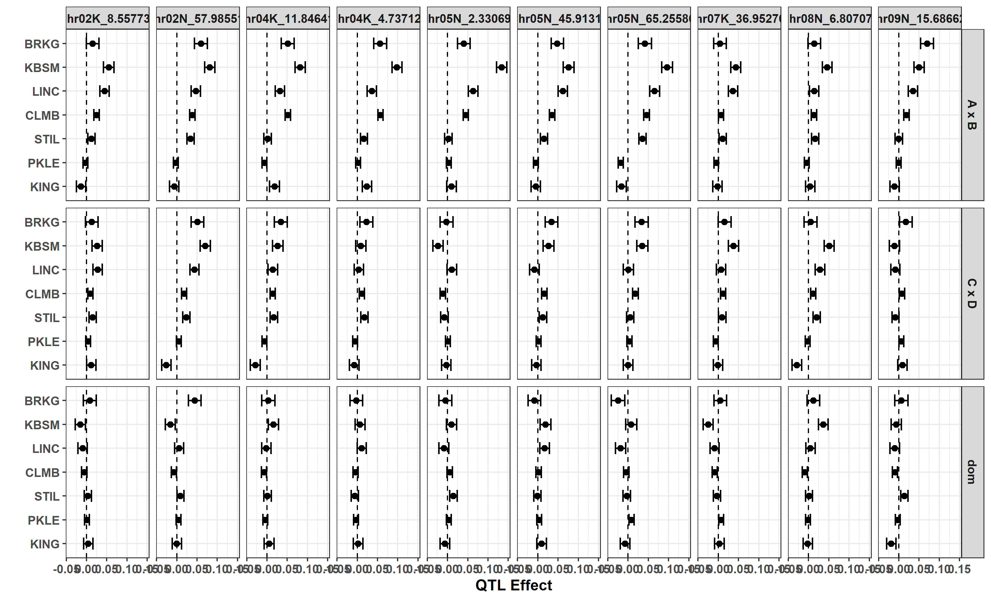
QTL allelic effects for daylength at flowering

Slide 8
Known flowering time candidate genes
PRR5 8NG050900
FT 5KG044000
PRR7 2NG126000
(Paul’s 2017 FT GWAS; Taylor FIPS ‘GWAS’ – but both used previous version of annotation, and these are very hard to compare)

